Slide 1

Analysis of Algorithm
Lecture 8
By
Huma Ayub

Slide 2
HASHING

Slide 3
Hash Tables
All search structures so far
Relied on a comparison operation
Performance O(n) or O( log n)
Assume I have a function
f ( key ) → integer
i.e one that maps a key to an integer
What performance might I expect now?

Slide 4
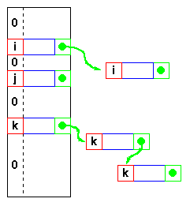
Hash Tables -
Keys are integers
Need a hash function h( key ) → integer
ie one that maps a key to an integer
Applying this function to the key produces an address
If h maps each key to a unique integer in the range 0 .. m-1 then search is O(1)

Slide 5
Hash Tables - Hash functions
Form of the hash function
Example - using an n-character key
int hash( char *s, int n ) { int sum = 0; while( n-- ) sum = sum + *s++; return sum % 256; } returns a value in 0 .. 255
xor function is also commonly used sum = sum ^ *s++;
Example
hash( “AB”, 2 ) and hash( “BA”, 2 ) return the same value! This is called a collision
A variety of techniques are used for resolving collisions

Slide 6
Hashing: Collision Resolution Schemes
Collision Resolution Techniques
Separate Chaining
Separate Chaining with String Keys
Separate Chaining versus Open-addressing
Implementation of Separate Chaining
Introduction to Collision Resolution using Open Addressing
Linear Probing

Slide 7
Collision Resolution Techniques
There are two broad ways of collision resolution:
1. Separate Chaining:: An array of linked list implementation.
2. Open Addressing: Array-based implementation.
(i) Linear probing (linear search)
(ii) Quadratic probing (nonlinear search)
(iii) Double hashing (uses two hash functions)

Slide 8
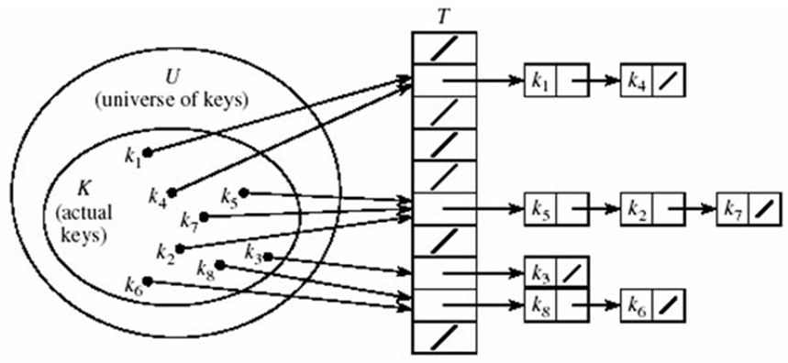
Separate Chaining
The hash table is implemented as an array of linked lists.
Inserting an item, r, that hashes at index i is simply insertion into the linked list at position i.
identicals are chained in the same linked list.

Slide 9
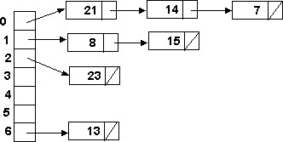
Separate Chaining (cont’d)
Retrieval of an item, r, with hash address, i, is simply retrieval from the linked list at position i.
Deletion of an item, r, with hash address, i, is simply deleting r from the linked list at position i.
Example: Load the keys 23, 13, 21, 14, 7, 8, and 15 , in this order, in a hash table of size 7 using separate chaining with the hash function: h(key) = key % 7
h(23) = 23 % 7 = 2
h(13) = 13 % 7 = 6
h(21) = 21 % 7 = 0
h(14) = 14 % 7 = 0 collision
h(7) = 7 % 7 = 0 collision
h(8) = 8 % 7 = 1
h(15) = 15 % 7 = 1 collision

Slide 10
Separate Chaining with String Keys
Recall that search keys can be numbers, strings or some other object.
A hash function for a string s = c0c1c2…cn-1 can be defined as:
hash = (c₀ + c₁ + c₂ + … + c_{n-1}) % tableSize
this can be implemented as:
Example: The following class describes commodity items:
public static int hash(String key, int tableSize){
int hashValue = 0;
for (int i = 0; i < key.length(); i++){
hashValue += key.charAt(i);
}
return hashValue % tableSize;
}
class CommodityItem {
String name; // commodity name
int quantity; // commodity quantity needed
double price; // commodity price
}

Slide 11
Separate Chaining with String Keys (cont’d)
Use the hash function hash to load the following commodity items into a hash table of size 13 using separate chaining:
onion 1 10.0
tomato 1 8.50
cabbage 3 3.50
carrot 1 5.50
okra 1 6.50
mellon 2 10.0
potato 2 7.50
Banana 3 4.00
olive 2 15.0
salt 2 2.50
cucumber 3 4.50
mushroom 3 5.50
orange 2 3.00
Solution:
hash(onion) = (111 + 110 + 105 + 111 + 110) % 13 = 547 % 13 = 1
hash(salt) = (115 + 97 + 108 + 116) % 13 = 436 % 13 = 7
hash(orange) = (111 + 114 + 97 + 110 + 103 + 101)%13 = 636 %13 = 12
Notes:
11

Slide 12
Separate Chaining with String Keys (cont’d)
0
1
2
3
4
5
6
7
8
9
10
11
12
okra
potato
onion
carrot
Item Qty Price h(key)
onion 1 10.0 1
tomato 1 8.50 10
cabbage 3 3.50 4
carrot 1 5.50 1
okra 1 6.50 0
mellon 2 10.0 10
potato 2 7.50 0
Banana 3 4.0 11
olive 2 15.0 10
salt 2 2.50 7
cucumber 3 4.50 9
mushroom 3 5.50 6
orange 2 3.00 12
cabbage
mushroom
salt
cucumber
tomato
mellon
olive
banana
orange

Slide 13
Separate Chaining versus Open-addressing
Organization Advantages Disadvantages
Chaining Unlimited number of elements Unlimited number of collisions Overhead of multiple linked lists

Slide 14
Introduction to Open Addressing
All items are stored in the hash table itself.
In addition to the cell data (if any), each cell keeps one of the three states: EMPTY, OCCUPIED, DELETED.
While inserting, if a collision occurs, alternative cells are tried until an empty cell is found.
Deletion: (lazy deletion): When a key is deleted the slot is marked as DELETED rather than EMPTY otherwise subsequent searches that hash at the deleted cell will be unsuccessful.
Probe sequence: A probe sequence is the sequence of array indexes that is followed in searching for an empty cell during an insertion, or in searching for a key during find or delete operations.
The most common probe sequences are of the form:
h_{i}(key) = [h(key) + c(i)] % n, for i = 0, 1, …, n-1.
where h is a hash function and n is the size of the hash table
The function c(i) is required to have the following two properties:
Property 1: c(0) = 0
Property 2: The set of values {c(0) % n, c(1) % n, c(2) % n, . . . , c(n-1) % n} must be a permutation of {0, 1, 2,. . ., n – 1}, that is, it must contain every integer between 0 and n - 1 inclusive.

Slide 15
Introduction to Open Addressing (cont’d)
The function c(i) is used to resolve collisions.
To insert item r, we examine array location h₀(r) = h(r). If there is a collision, array locations h₁(r), h₂(r), ..., h_{n-1}(r) are examined until an empty slot is found.
Similarly, to find item r, we examine the same sequence of locations in the same order.
Note: For a given hash function h(key), the only difference in the open addressing collision resolution techniques (linear probing, quadratic probing and double hashing) is in the definition of the function c(i).
Common definitions of c(i) are:
Collision resolution technique | c(i)
Linear probing | i
Quadratic probing | ±i²
Double hashing | i*h_{p}(key)
where h_{p}(key) is another hash function.

Slide 16
Introduction to Open Addressing (cont'd)
Advantages of Open addressing:
All items are stored in the hash table itself. There is no need for another data structure(MEANS NO LINKLIST).
Open addressing is more efficient storage-wise.
Disadvantages of Open Addressing:
The keys of the objects to be hashed must be distinct.
Dependent on choosing a proper table size.
Requires the use of a three-state (Occupied, Empty, or Deleted) flag in each cell.

Slide 17
Open Addressing Facts
In general, the best table size is most important.
With any open addressing method of collision resolution, as the table fills, there can be a severe degradation in the table performance.
Hashing has two parameters that affect its performance: initial capacity and load factor.
The capacity is the number of buckets in the hash table, and the initial capacity is simply the capacity at the time the hash table is created.
The load factor is a measure of how full the hash table is allowed to get before its capacity is automatically increased. i.e
When the number of entries in the hash table exceeds the product of the load factor and the current capacity, the capacity is roughly doubled by calling the rehash method.
As a general rule, the default load factor (.75) offers a good tradeoff between time and space costs.
The load factor of the table is m/N, where m is the number of distinct indexes used in the table or is the number of records currently in the table. and N is the size of the array used to implement it.
Load factors between 0.6 and 0.7 are common.
Load factors > 0.7 are undesirable.

Slide 18
Open Addressing : Linear Probing (cont’d)
Example: Perform the operations given below, in the given order, on an initially empty hash table of size 13 using linear probing with c(i) = i and the hash function: h(key) = key % 13:
insert(18), insert(26), insert(35), insert(9), find(15), find(48), delete(35), delete(40), find(9), insert(64), insert(47), find(35)
The required probe sequences are given by:
h_{i}(key) = (h(key) + i) % 13
i = 0, 1, 2, . . ., 12

Slide 19
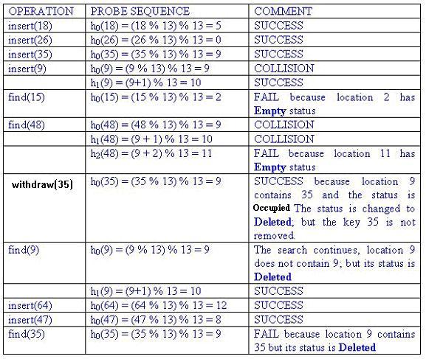
a
Linear Probing (cont’d)
Index | Status | Value
0 | O | 26
1 | E
2 | E
3 | E
4 | E
5 | O | 18
6 | E
7 | E
8 | O | 47
9 | D | 35
10 | O | 9
11 | E
12 | O | 64

Slide 20
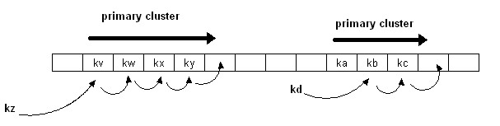
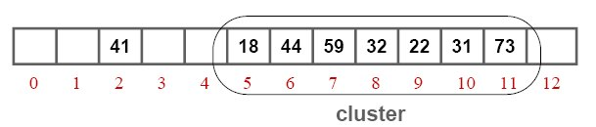
Disadvantage of Linear Probing: Primary Clustering
Linear probing is subject to a primary clustering phenomenon.
Elements tend to cluster around table locations that they originally hash to.
Primary clusters can combine to form larger clusters. This leads to long search
sequences and hence decline in hash table efficiency.
Example of a primary cluster: Insert keys: 18, 41, 22, 44, 59, 32, 31, 73, in this order, in an originally empty hash table of size 13, using the hash function h(key) = key % 13 and c(i) = i:
h(18) = 5
h(41) = 2
h(22) = 9
h(44) = 5+1
h(59) = 7
h(32) = 6+1+1
h(31) = 5+1+1+1+1+1
h(73) = 8+1+1+1

